Slide 1
Charge Route : Building a webapp for range estimation & showing nearest charging station for EV
PIP2001 Capstone Project
Final Viva Voce
Batch Number: CST-G10
Roll Number | Student Name
20211CST0056 20211CST0033 20211CST0109 | AANCHAL SAMEER MAIMOONA MAHMOOD T TARA CHANDRA SAI REDDY
20201CST0015 | INDRAJITH M
Under the Supervision of,
Ms. Radhika Sreedharan
Assistant Professor
School of Computer Science and Engineering
Presidency University
Name of the Program: B.Tech - CST AIML
Name of the HoD: Dr. Saira Banu
Name of the Program Project Coordinator: Dr. Manjula H M
Name of the School Project Coordinators: Dr. Sampath A K / Dr. Abdul Khadar A / Mr. Md Ziaur Rahman

Slide 2
Introduction
"Charge Route" is a web application designed to assist electric vehicle (EV) owners in estimating their vehicle's range and locating nearby charging stations.
Deals with range anxiety — the fear that an EV will run out of battery before reaching a charging station.
Integrating user inputs with geospatial algorithms and Google Maps services, the app delivers real-time, accurate information on the closest charging points, alleviating range anxiety and enabling efficient trip planning.
In addition to its core functionality, "Charge Route" promotes the adoption of EVs by making access to clean energy infrastructure more convenient, contributing to reduced carbon emissions and supporting eco-friendly urban mobility.

Slide 3
Literature Review
Jin, X., & Chen, T. D. (2020). Predicting the locations of electric vehicle charging stations using a multi-objective optimization model. Transport Policy, 88, 123-134.
This paper presents a multi-objective optimization model for predicting optimal locations for charging stations, considering factors like demand, accessibility, and infrastructure costs.
Siddiqui, A. F., & Kabir, E. (2021). A review of electric vehicle charging station deployment: Current status and future prospects. Journal of Energy Storage, 43, 103176.
This review article discusses the current state of charging station deployment globally
Cao, Y., & Zhao, X. (2021). An integrated model for electric vehicle charging station planning with range anxiety consideration. Transportation Research Part A: Policy and Practice, 144, 47-62.
This study develops an integrated model that incorporates range anxiety into the planning of charging station networks, improving the overall efficiency of EV infrastructure.
Moussa, A., & Hu, C. (2020). A review of electric vehicle range estimation methods: Current status and future directions. Renewable and Sustainable Energy Reviews, 120, 109637.
This paper provides a comprehensive review of existing range estimation methods

Slide 4
Literature Review
Ehsani, M., Gao, Y., & Longo, S. (2018). Modern Electric, Hybrid Electric, and Fuel Cell Vehicles: Fundamentals, Theory, and Design. CRC Press.
This book discusses the fundamental principles of electric vehicle technology, including battery management systems and range estimation.
Wang, X., Li, W., & Li, W. (2021). A smart charging station locator for electric vehicles based on real-time data. Sustainable Cities and Society, 68, 102786.
This study presents a smart charging station locator that utilizes real-time data and user preferences to enhance the charging experience for EV users.
Zhang, X., & Liu, C. (2021). Analysis of electric vehicle range anxiety based on consumer behavior. Energy Policy, 150, 112070.
This research explores the psychological aspects of range anxiety among EV consumers

Slide 5
Literature Review
Yang, S., & He, Z. (2019). Development and application of a decision support system for electric vehicle charging infrastructure planning. Energies, 12(19), 3731.
This paper discusses a decision support system designed to optimize the planning of electric vehicle charging infrastructure, including location and accessibility factors that enhance user convenience.
Berkelaar, M., & H. Verhoef, E. (2020). The impact of charging station information on electric vehicle adoption: A behavioral analysis. Transportation Research Part D: Transport and Environment, 84, 102360.
This article examines how the availability and accuracy of charging station information influence consumer behavior and the adoption rate of electric vehicles.
Hao, H., Liu, Z., & Wu, Y. (2021). The role of big data in optimizing electric vehicle charging station location and network design. Computers, Environment and Urban Systems, 85, 101561.
This paper discusses how big data analytics can be leveraged to optimize the location and design of electric vehicle charging networks, enhancing user accessibility and experience.

Slide 6
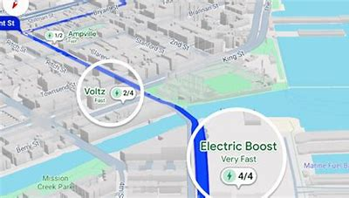
Research Gaps Identified
Charging Station Availability
Current State: Displays nearby EV charging stations using Google Maps API.
Gap: Does not account for real-time station availability, queue length, or operational status.
Improvement Opportunity: Integrate live data feeds from charging networks to provide real-time station availability and estimated wait times.
Figure 1: Operational status of the charging stations.

Slide 7
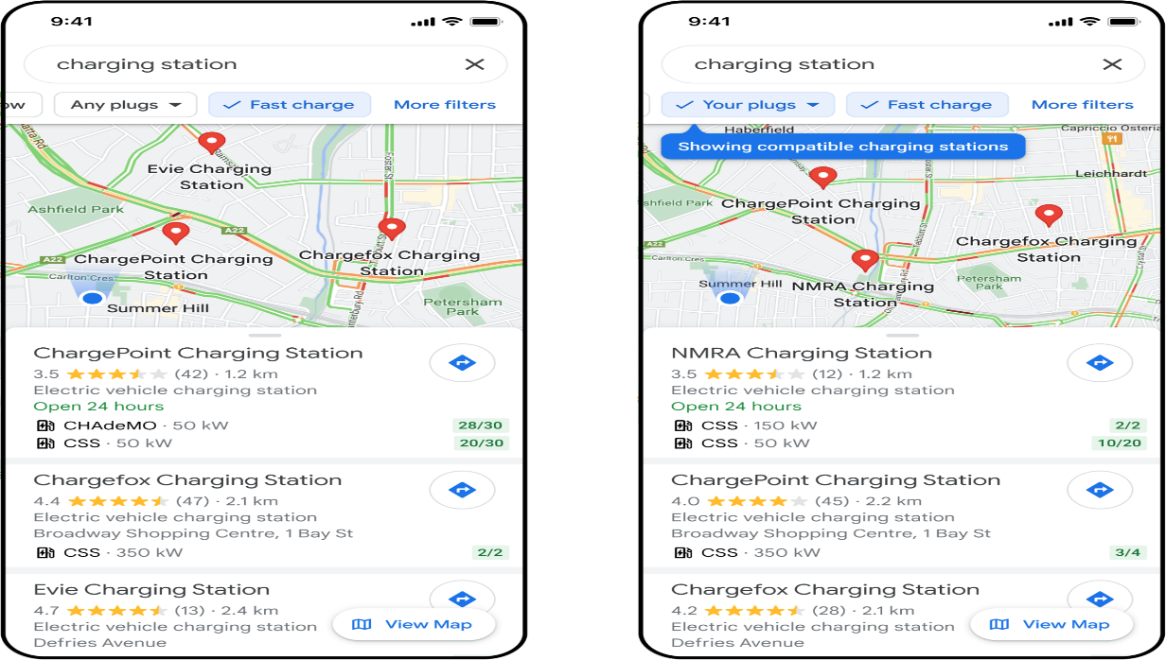
Research Gaps Identified
User Personalization
Current State: Generalized recommendations.
Gap: Lack of personalized features based on user preferences, such as favorite stations, preferred charger types (e.g., fast chargers), or budget.
Improvement Opportunity: Implement user profiles and preferences for a tailored experience.
Figure 2: Apply filters for personalized results

Slide 8
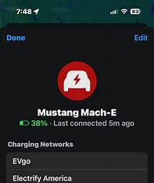
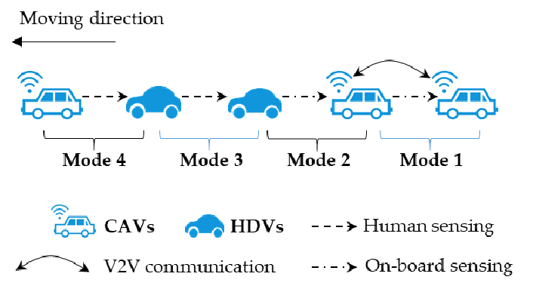
Research Gaps Identified
Integration with Vehicle Systems
Current State: Standalone app.
Gap: Limited integration with vehicle telematics systems to fetch live battery status, energy consumption patterns, driving modes (eco, sport, etc.) and navigation data.
Improvement Opportunity: Explore APIs from EV manufacturers to integrate vehicle-specific data and also use the vehicle data via importing int onto the app.
Figure 3: Vehicle Modes
Figure 4: Vehicle data to be imported to app.

Slide 9
Existing method Drawback
Shortest Path Algorithm (e.g., Dijkstra's Algorithm):
Not Real-Time: Traditional shortest path algorithms ignore real-time factors like traffic, road closures, or weather, affecting actual driving range.
Single Objective: It optimizes only for distance and may not consider factors like road quality or charging station availability.
Machine Learning-Based Prediction Models:
Data Dependency: Requires a large amount of historical and real-time data, which can be difficult to collect and manage.
Generalization: The model may not generalize well to new situations
K-Nearest Neighbors (KNN) for Station Recommendations:
Scalability Issues: KNN is a lazy algorithm and can become computationally expensive as the number of charging stations increases.
Static Recommendation: May not account for real-time factors such as station availability or traffic congestion.

Slide 10
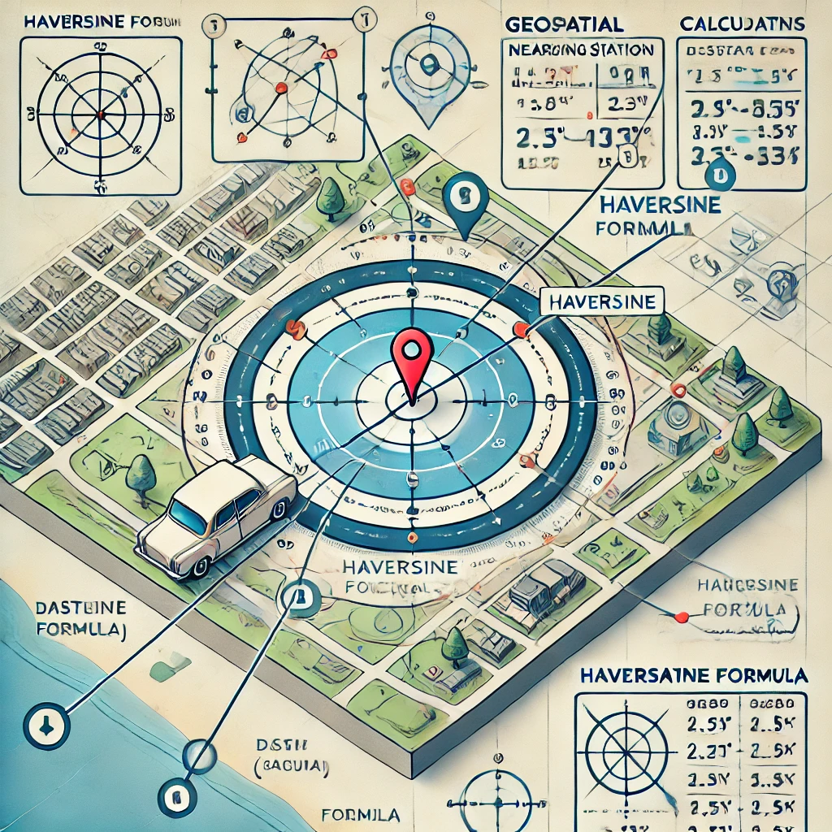
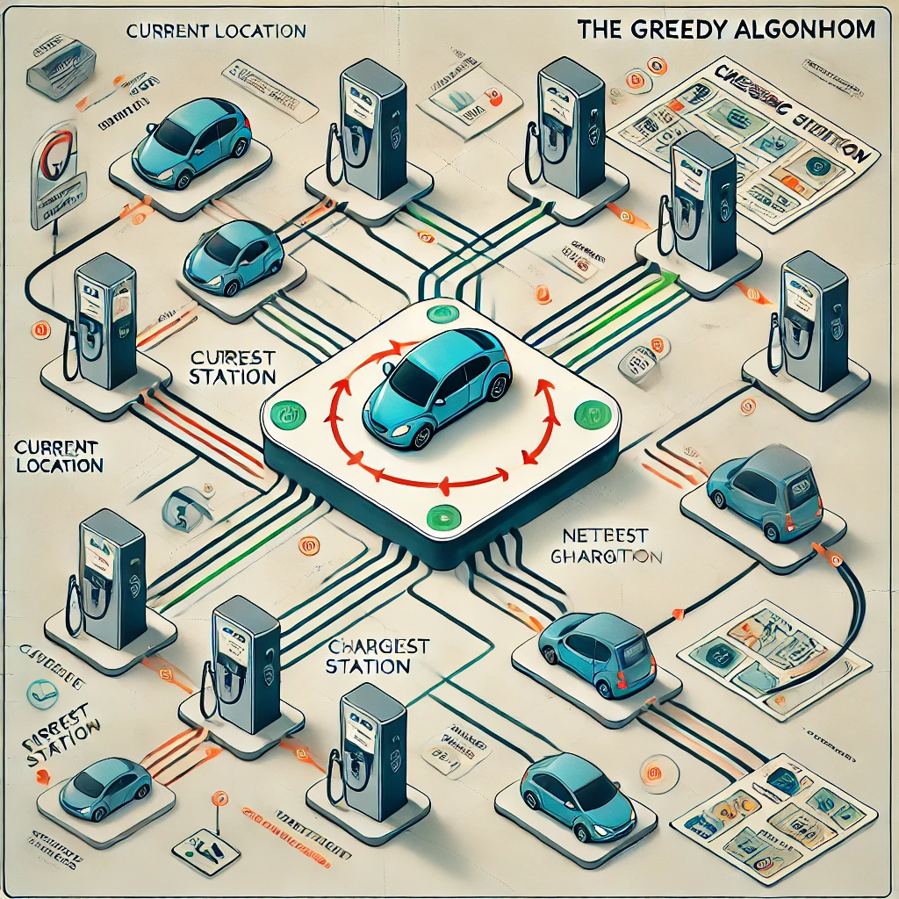
Proposed Method
GEOSPATIAL ALGORITHM
(HAVERSINE FORMULA)
GREEDY ALGORITHM

Slide 11
Proposed Methodology
Geospatial Algorithm
(Haversine Formula)
Greedy Algorithm
The Geospatial Algorithm uses the Haversine formula to calculate distances between the user’s current location (latitude and longitude) and the locations of various charging stations. This helps in determining which stations fall within a certain range.
Accurately identify nearby charging stations within a user-defined radius.
Once the charging stations are identified using the Geospatial Algorithm, the Greedy Algorithm chooses the closest one based solely on the distance, without considering other factors. This allows users to get instant recommendations for where they can recharge.
Real-time algorithms that consider real-time factors i.e. road conditions, traffic, vehicle parameters etc.

Slide 12
Objectives
Range Estimation: Provide accurate EV travel distance based on battery percentage and efficiency.
Charging Station Locator: Help users find nearby EV charging stations for convenience.
User-Friendly Interface: Ensure smooth navigation with an intuitive, responsive design.
Google Maps Integration: Use Google Maps API for real-time location and charging station mapping.
Sustainable Mobility: Support EV adoption by easing access to charging infrastructure and reducing emissions.
6. Data-Driven Insights: Analyze user data to improve app performance and user experience.

Slide 13
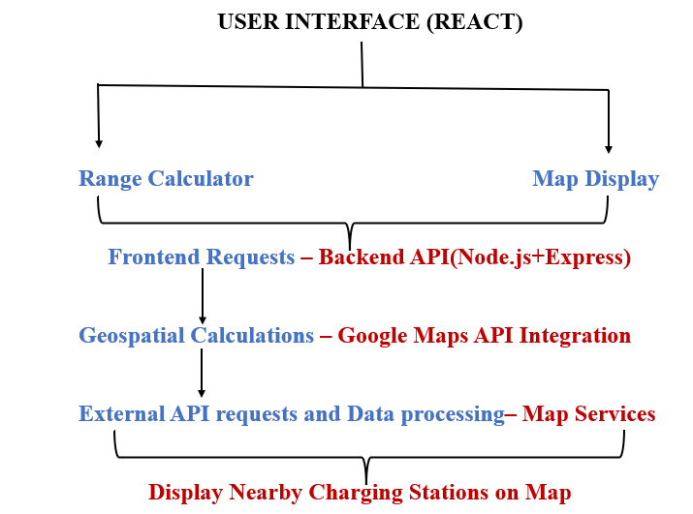
System Design & Implementation

Slide 14
Modules
Frontend Modules:
Range Calculator (EVRangeEstimator.js ): User inputs battery level or range; calculates maximum travel distance.
Map Display (ChargingStations.js): Integrates Google Maps API to show interactive map with nearby charging stations.
UI Components (App.js, App.css): Clean, responsive design for seamless navigation.
Backend Modules:
Controller (Index.js): Processes user input, calculates distances, integrates with Google Maps API.
Endpoint for Range Calculation :Defines endpoints, handles requests and input validation.
GET /api/range is used to accept query parameters such as batteryLevel and consumptionRate.
Server (server.js): Initializes Express server, sets up middleware.
External Services:
Dynamic Google API: Fetches user location, displays maps, and identifies nearby charging stations.

Slide 15
Software components
Frontend:
React : A JavaScript library for building user interfaces. It manages the state and rendering of the components.
Google Maps API : Provides map functionalities, including location autocomplete and places search.
Backend:
Node.js & Express : Handles server-side logic, API requests, and integration with other services. This is relevant if you have a backend to handle additional features or API calls.

Slide 16
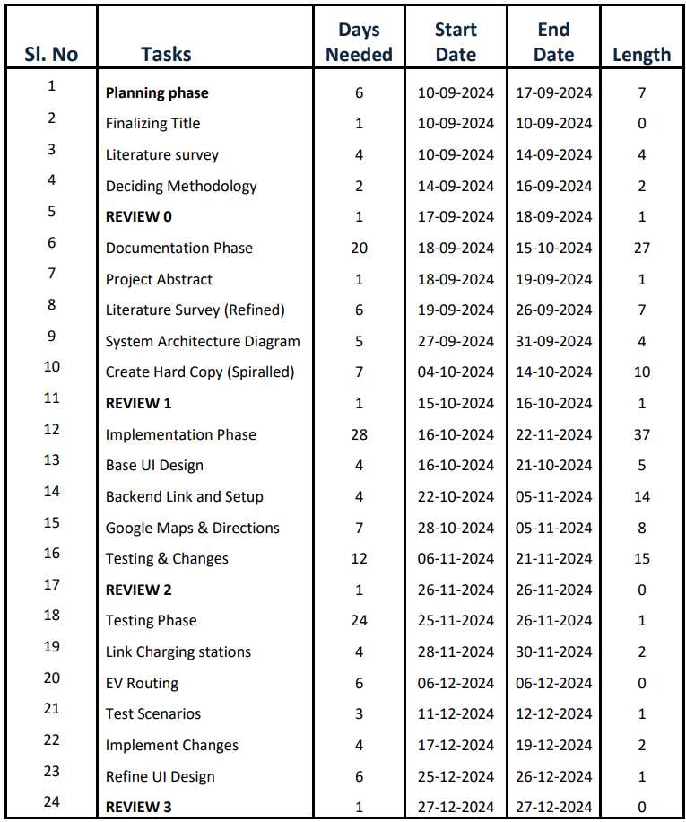
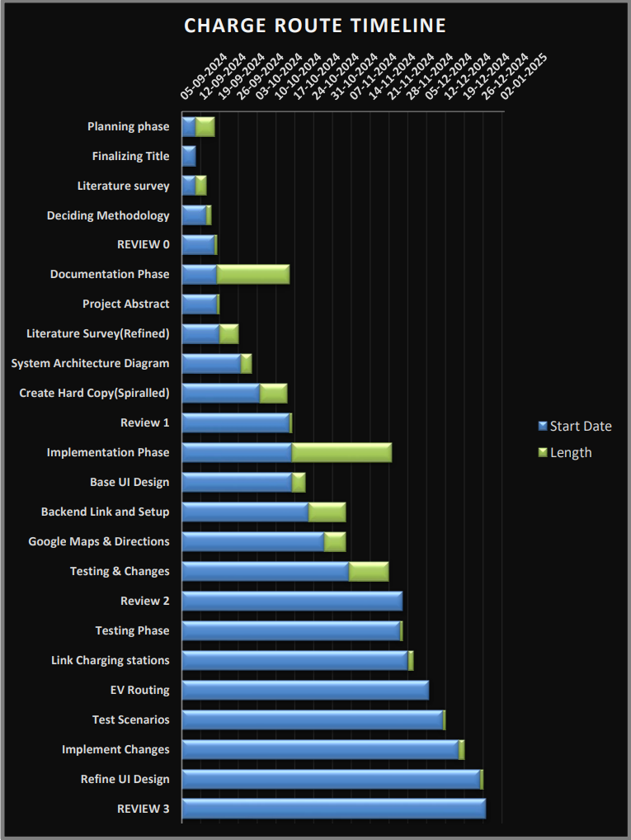
Timeline of the Project (Gantt Chart)

Slide 17
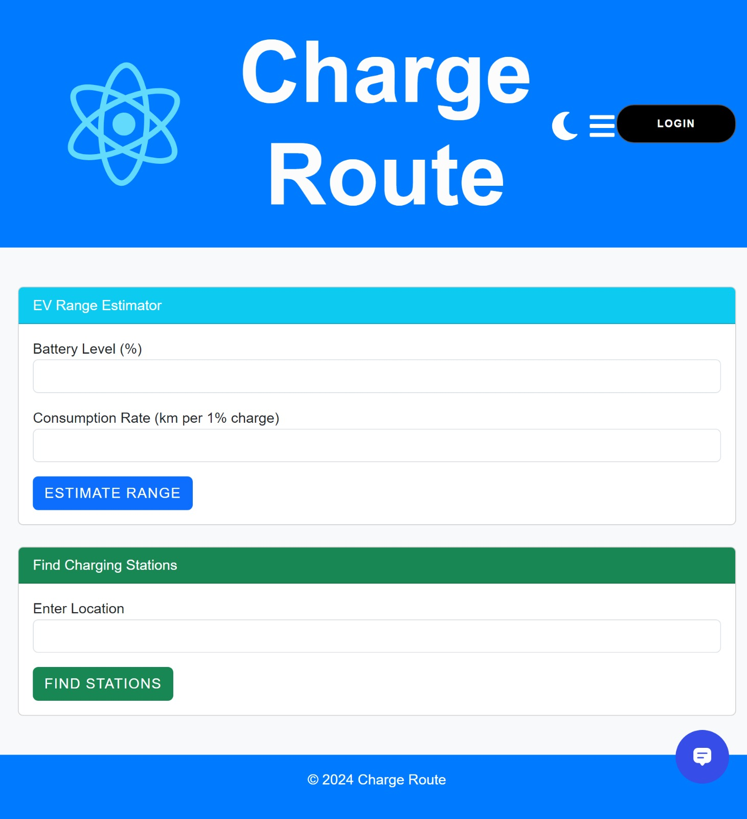
Outcomes / Results Obtained
Menu Button
Login Button
Theme adjustment Button
Range Estimator
Charging Station Locator
Personalized AI Chat Assistant

Slide 18
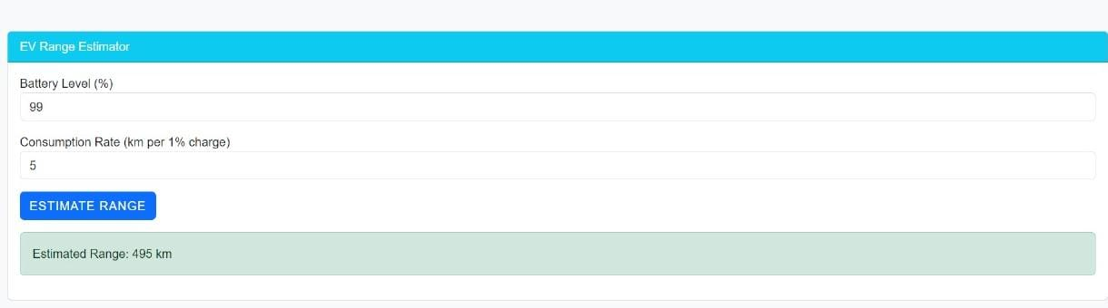
Outcomes / Results Obtained
Sample On How Range is Estimated.

Slide 19
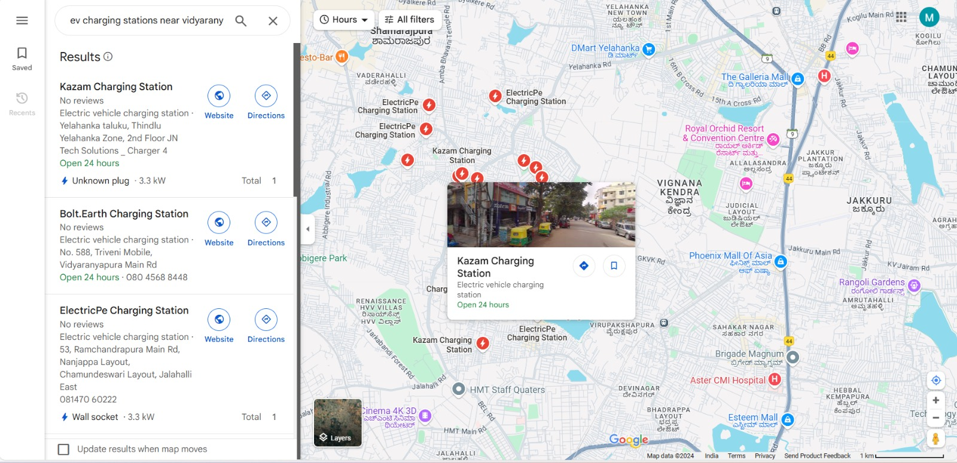
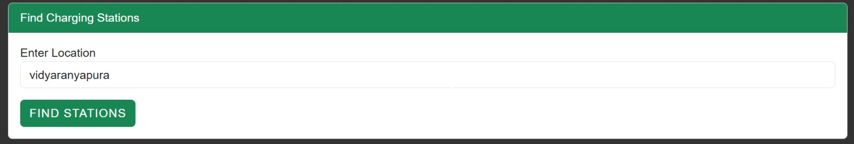
Outcomes / Results Obtained
Map Integration (Dynamic)

Slide 20

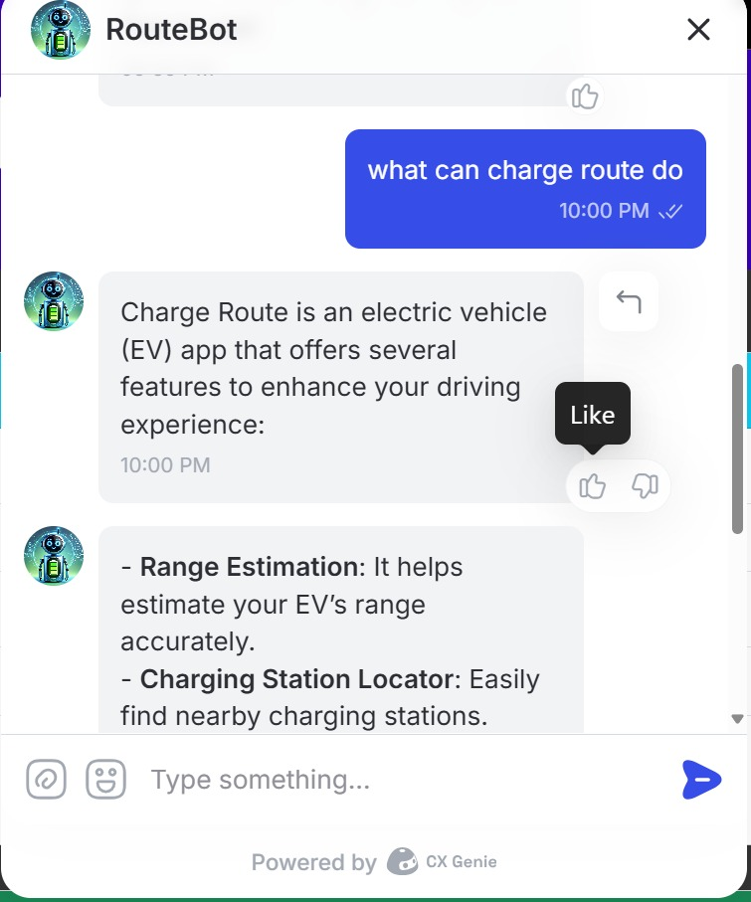

Outcomes / Results Obtained
Personalized AI Chat Assistant

Slide 21
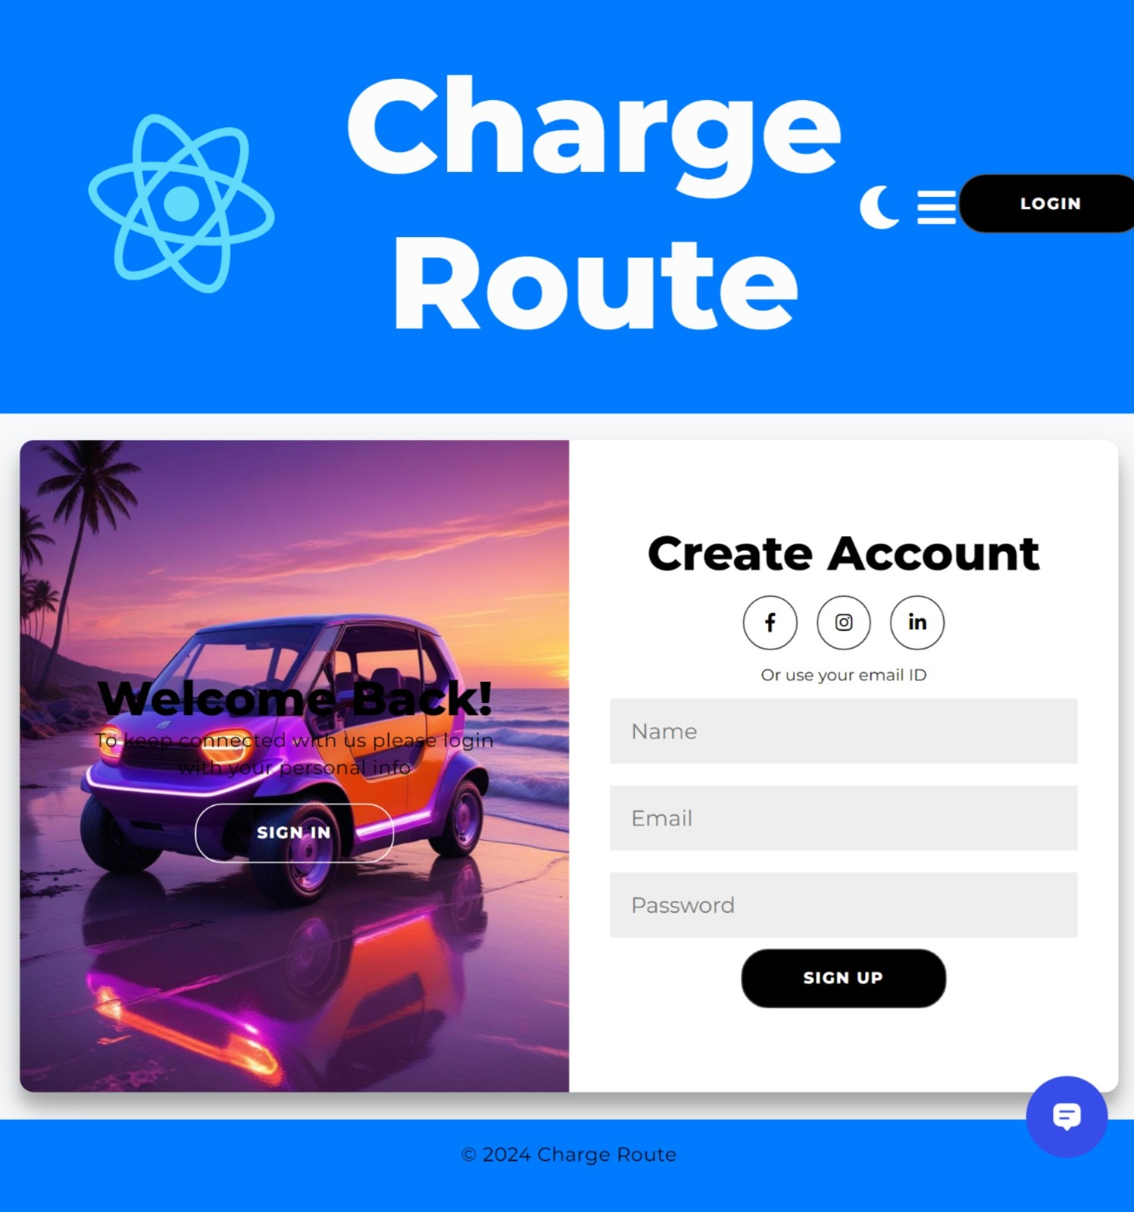
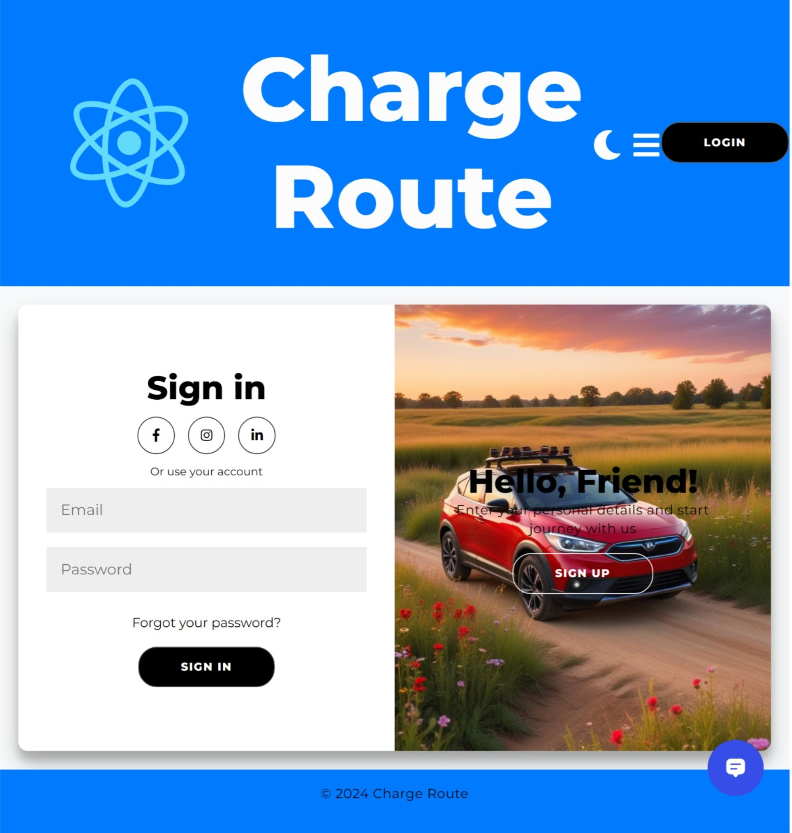
Outcomes / Results Obtained
If you don’t have an account login.
If having an account sign in.

Slide 22
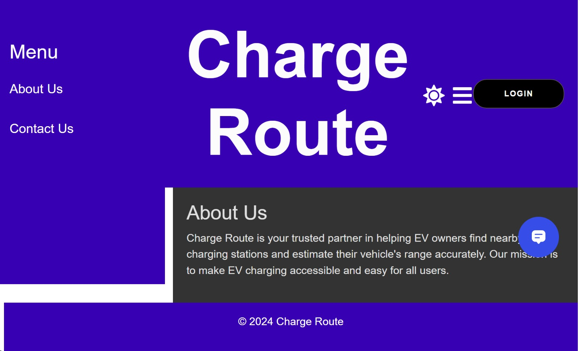
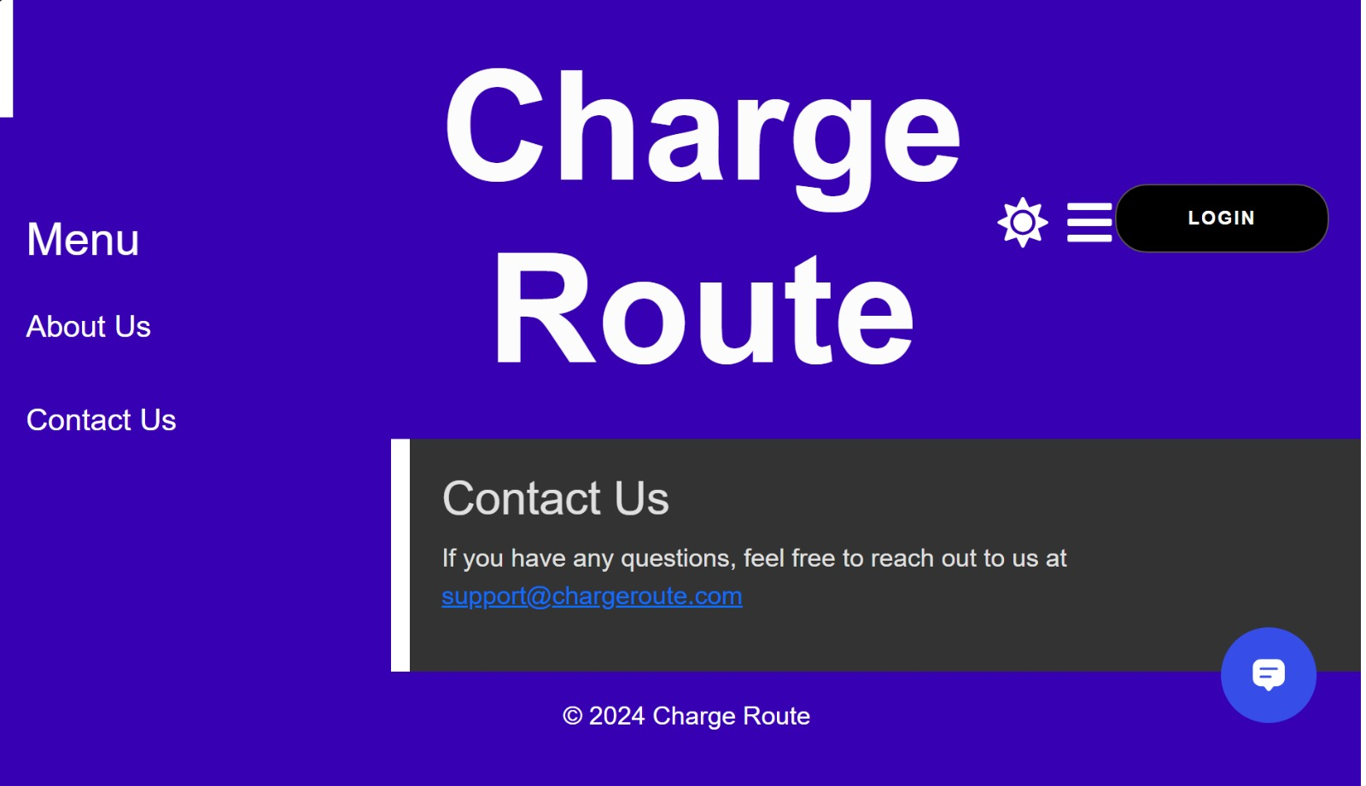
Outcomes / Results Obtained
Menu -> About Us
Menu -> Contact Us

Slide 23
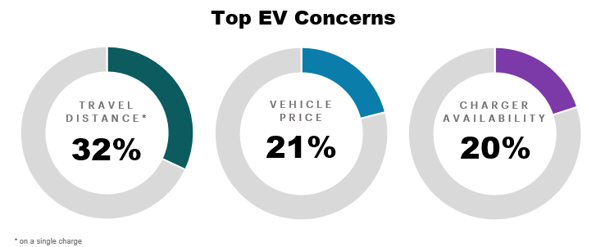
Outcomes
Reliable EV Range Estimation.
Efficient Charging Station Location.
Improved User Convenience This project aims to counter the major problem related to EV
Reduced Range Anxiety
Support for Sustainable Transportation
Enhanced EV Adoption
Foundation for Future Development.

Slide 24
Conclusion
The "Charge Route" web application plays a crucial role in supporting electric vehicle (EV) users by addressing the widespread issue of range anxiety. Through its advanced features—such as precise range estimation and a real-time charging station locator—the app significantly enhances the overall EV ownership experience.
By seamlessly integrating cutting-edge geospatial algorithms with an intuitive, user-friendly interface and the Google Maps API, "Charge Route" not only fosters sustainable urban mobility but also contributes to the global transition toward cleaner energy solutions.
As the adoption of electric vehicles continues to accelerate, "Charge Route" is strategically positioned to facilitate this shift, ensuring that EV owners can travel with confidence and convenience.

Slide 25
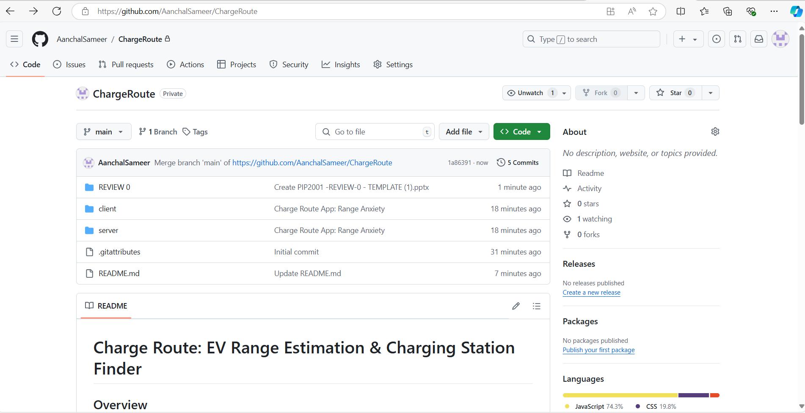
Github Link
ChargeRoute Git

Slide 26
References (IEEE Paper format)
Tiwary, A., Mishra, S., & Kumar, U. (2024). Electric vehicle range estimation based on driving behaviour employing long short-term memory neural network. 2024 International Symposium on Power Electronics, Electrical Drives, Automation and Motion (SPEEDAM), 551-555. https://doi.org/10.1109/SPEEDAM61530.2024.10609085
Shekhar, A., Prasanth, V., Bauer, P., & Bolech, M. (2015). Generic methodology for driving range estimation of electric vehicle with on-road charging. 2015 IEEE Transportation Electrification Conference and Expo (ITEC), 1-8. https://doi.org/10.1109/ITEC.2015.7165763
Sağlam, B., Bostancı, E., & Göl, M. (2021). Parameter estimation of electric vehicles for improved range prediction. 2021 IEEE PES Innovative Smart Grid Technologies Europe (ISGT Europe), 1-5. https://doi.org/10.1109/ISGTEurope52324.2021.9640048

Slide 27

Project work mapping with SDG
The "Charge Route" app aligns with the following SDGs:
SDG 7: By supporting the use of EVs and providing easy access to charging, it promotes clean energy.
SDG 9: The app's innovative use of geospatial technologies supports sustainable infrastructure and urban planning.
SDG 11: It helps make cities cleaner and more sustainable by encouraging EV adoption.
SDG 12: By optimizing routes and charging habits, it encourages responsible energy consumption.
SDG 13: The app contributes to reducing carbon emissions, supporting climate action efforts.
SDG 17: Collaboration with various partners can strengthen global efforts toward green mobility.

Slide 28
Publication Details
Title: WEB APPLICATION FOR EV RANGE ESTIMATION AND CHARGING STATION LOCATOR
Authors: ¹Aanchal Sameer, ²Maimoona Mahmood, ³Tara Chandra Sai Reddy, ⁴Indrajith M, ⁵Radhika Sreedharan.
Journal: International Journal of Innovative Research in Technology (IJIRT)
Published On: 13th Jan 2025 .
Published in Volume 11 Issue 8, January 2025.
Manuscript ID: 172091
Highlights:
Addresses range anxiety among EV users by providing accurate range estimation and locating nearby charging stations.
Enhances the overall EV ownership experience by empowering users with informed travel decisions.
Developed a web app leveraging Google Maps API for EV charging station navigation.
Integrated geospatial and greedy algorithms for efficient route optimization.
Access Link:
https://ijirt.org/Article?manuscript=172091

Slide 29
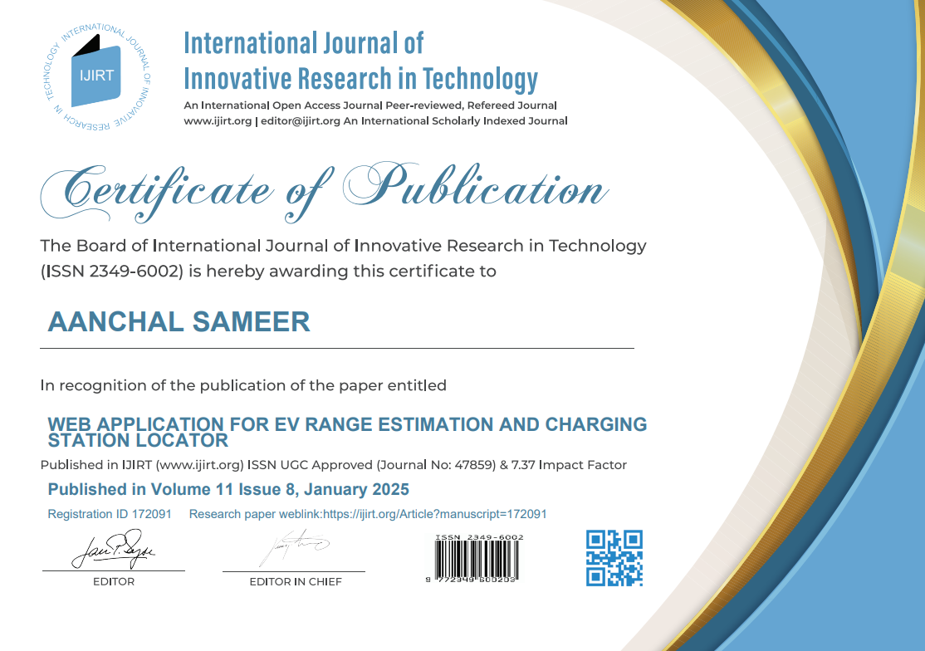
Achievements

Slide 30

Achievements

Slide 31
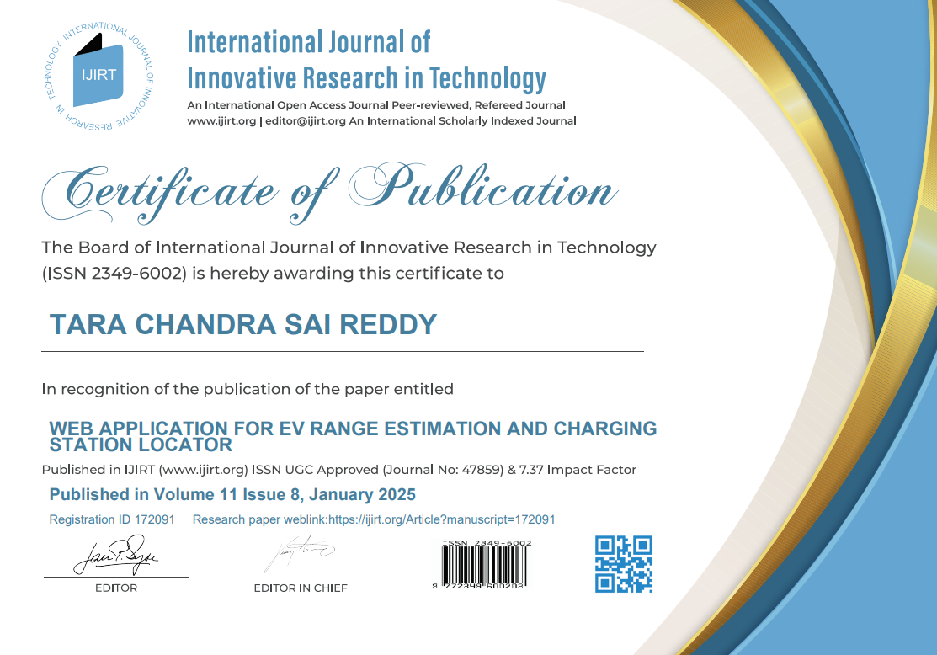
Achievements

Slide 32

Achievements

Slide 33

Achievements

Slide 34


